Slide 1
DAX Patterns

Slide 2
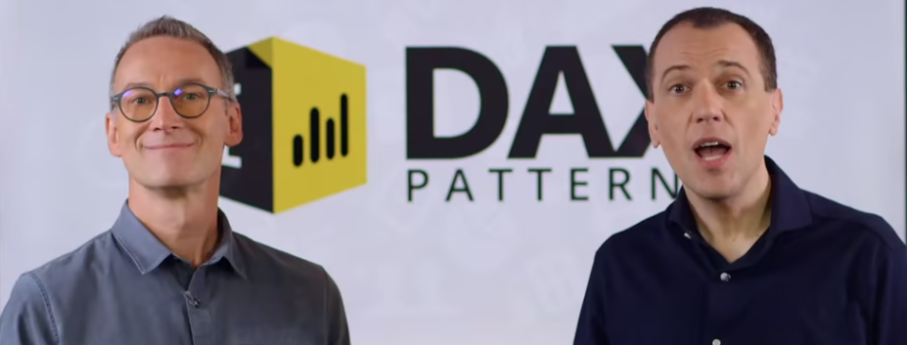
What is Patterns
Recurring Problem-Solution
Reusability!
Alberto Ferrari
Marco Russo

Slide 3
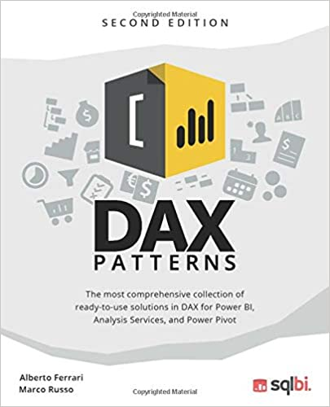
URLs
https://www.daxpatterns.com/
https://www.sqlbi.com/

Slide 4
Patterns Set
Time Patterns

